Slide 1
Student Placement Prediction System
Pratik Mohite
B.Tech Computer Science

Slide 2
Introduction
Predict student placement chances using Machine Learning
Helps students understand readiness
Provides actionable recommendations

Slide 3
Problem Statement
Students lack clarity on placement readiness
No personalized guidance
Need data-driven insights

Slide 4
Objective
Build ML model for prediction
Develop Flask web application
Provide improvement suggestions

Slide 5
Technologies Used
Python, Flask
HTML, CSS
Scikit-learn (Random Forest)
NumPy, Pandas

Slide 6
Dataset Features
CGPA, Internships, Projects
Coding & Communication Skills
Aptitude Score, Backlogs
Degree, Gender

Slide 7
Feature Engineering
avg_score = (CGPA + Internships + Projects) / 3
total_skills = Aptitude + Coding + Communication
is_weak = CGPA < 6

Slide 8
Model Building
Algorithm: Random Forest
Train-test split
Accuracy evaluation
Improved using engineered features

Slide 9
Web Application
User inputs student details
Flask processes input
Model predicts placement
Shows probability & recommendations

Slide 10
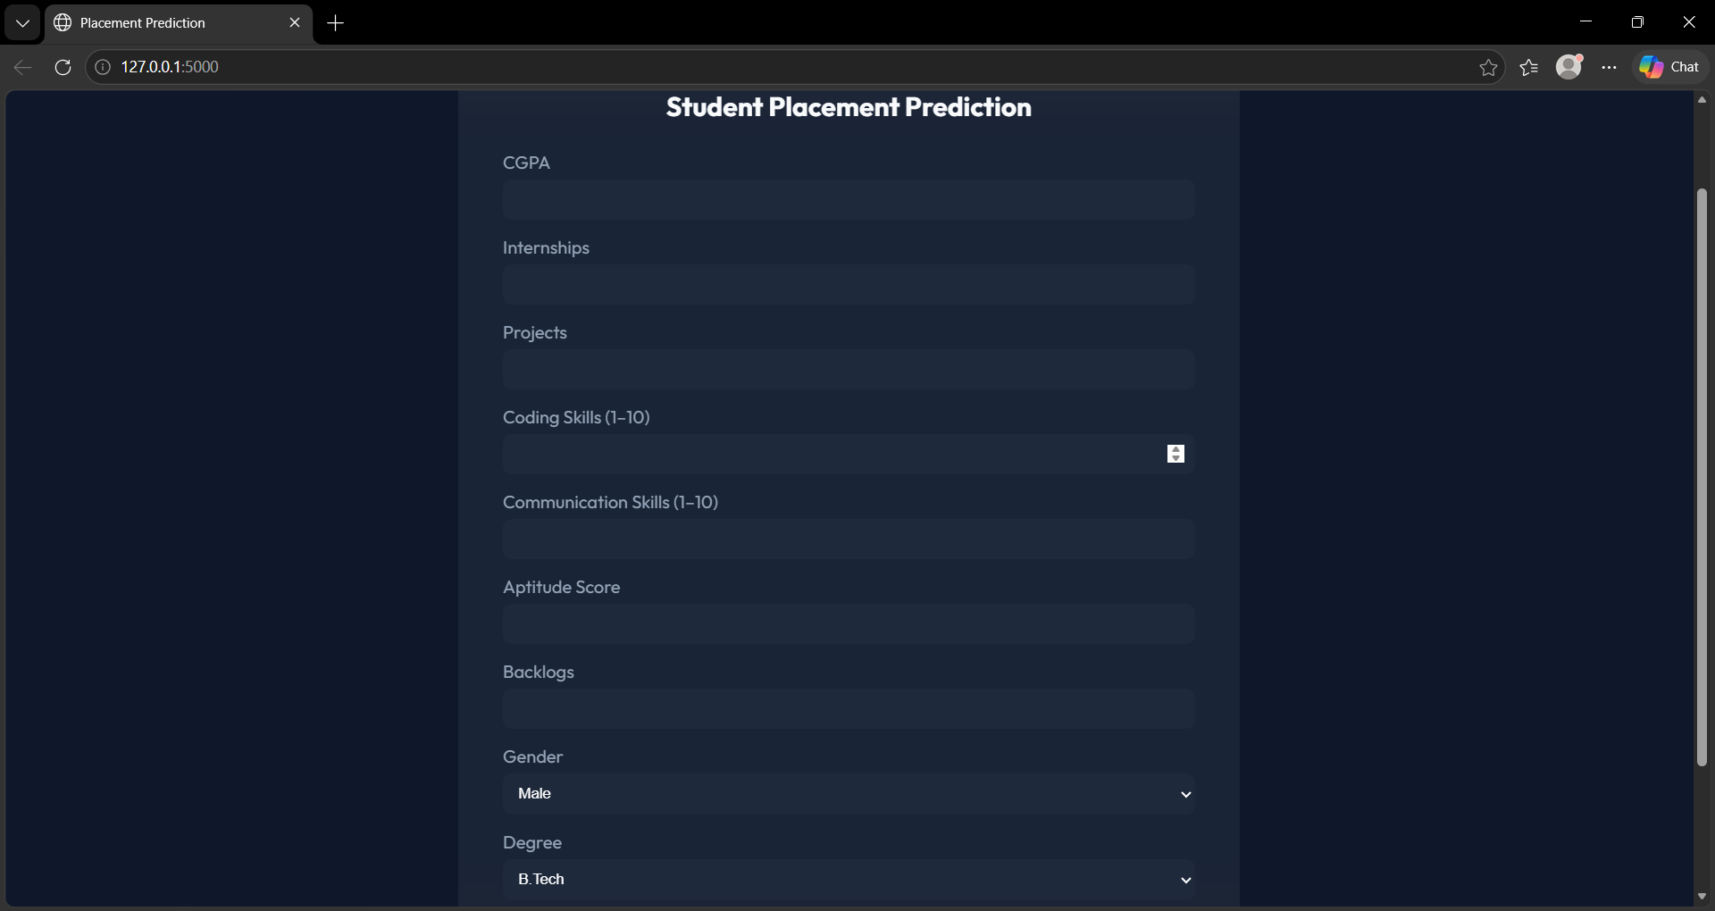
Images :

Slide 11
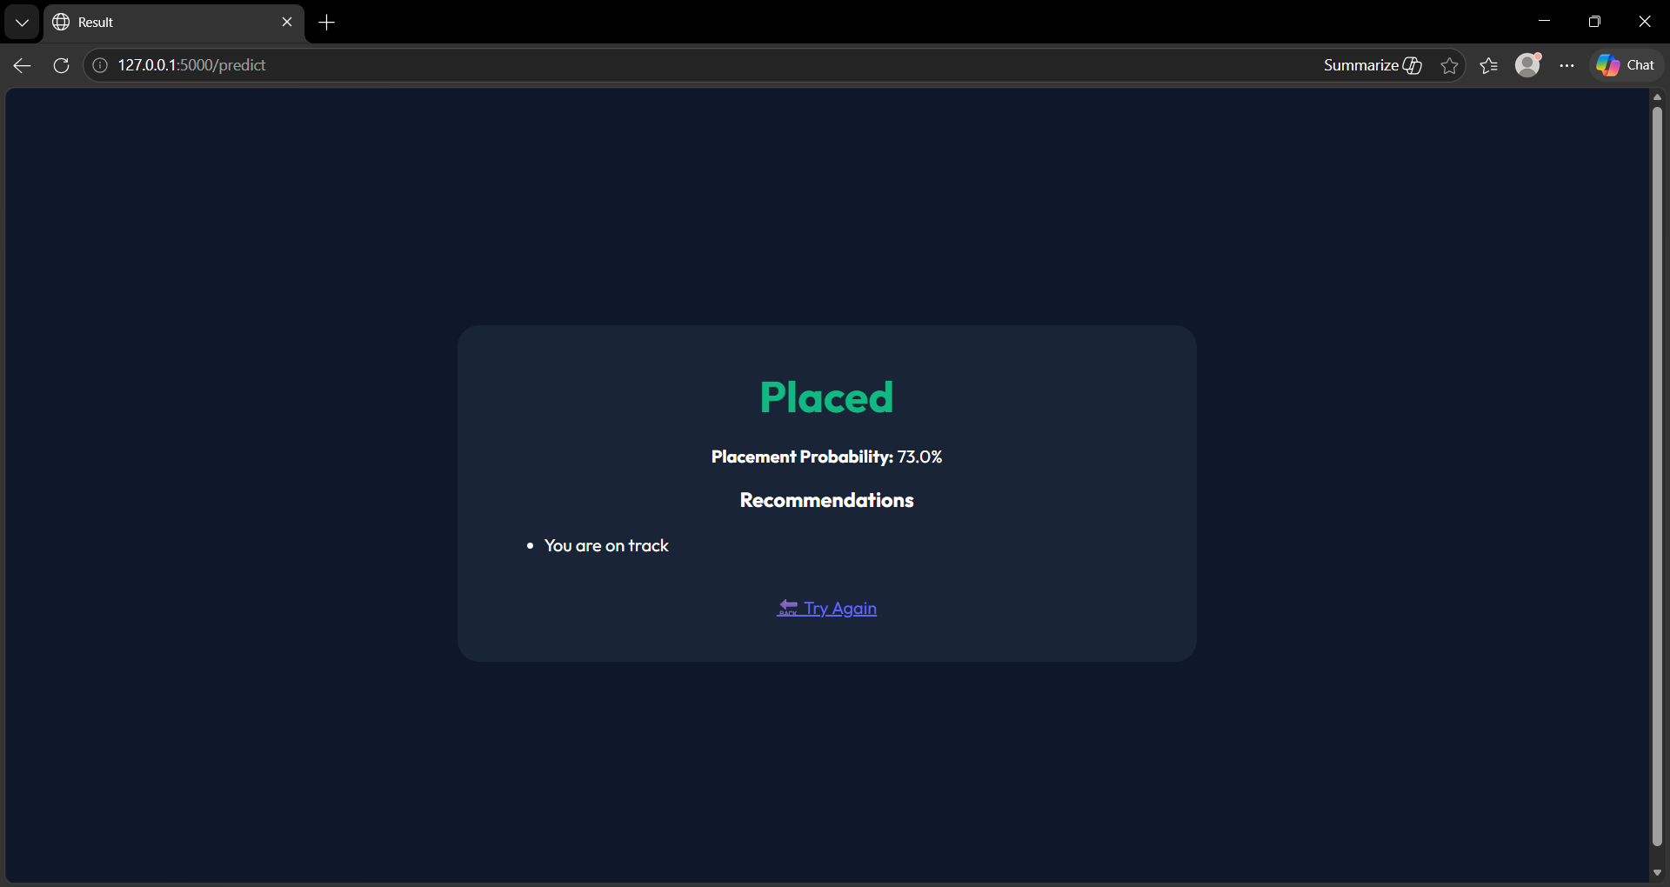
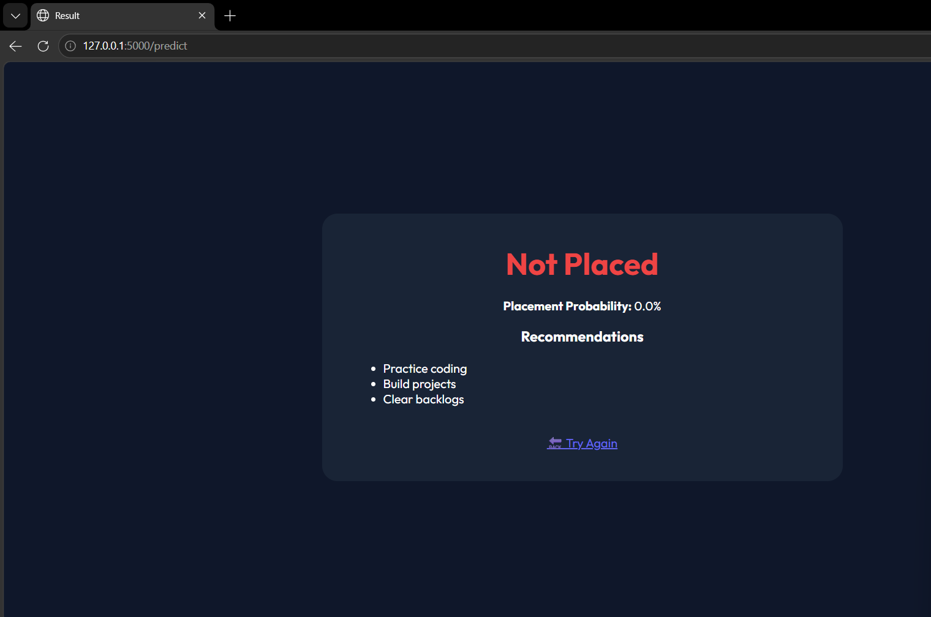

Slide 12
Conclusion
ML helps students improve placement chances
Provides personalized insights
Scalable real-world solution

